Slide 1



League of Legends Game prediction
MIDS 207 Final Project - Kevin Dai, Jian Wang

Slide 2

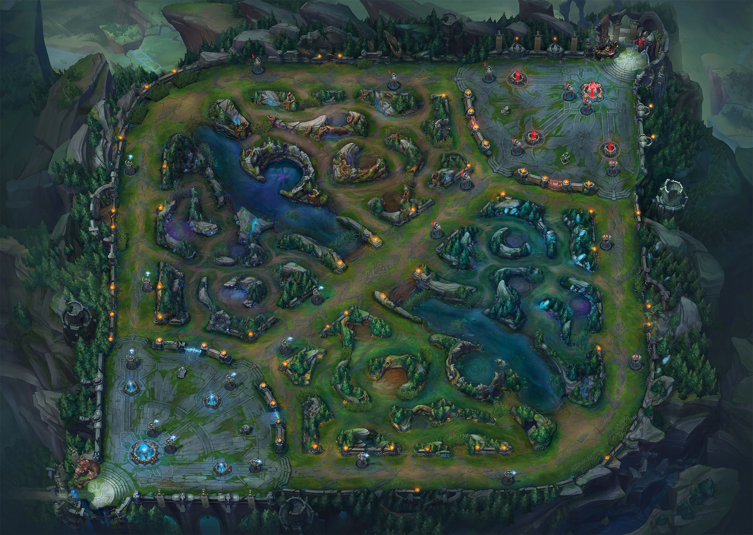
Problem
League of Legends is a popular 5 vs 5 online battle MOBA game where players choose champions with unique abilities and work together to destroy the opposing team's base.
Each game will take ~ 30 min in average, with tons of unique winning strategy & resources & equipment.
An important aspect of the game is competitive ranked play, which utilize a skill-based match-making system to form fair teams & games.
We believe that it’s possible to develop a real-time win rate prediction engine, based on in-game& out game features.

Slide 3
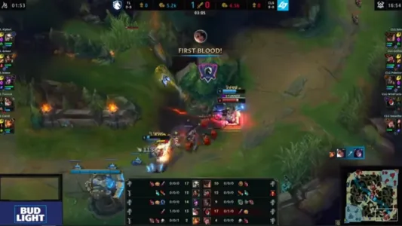
Example/Objectives:
Given early kill happened at 4 min by mid-laner player, how likely will this contribute to the win ?
Given Baron ( a neutral resources) is killed at 26 min, how likely will this contribute to the game?
How exactly is the matching engine works? If players all get filled on both sides, how exactly will that impact the game output?
How precisely will early game objective impact the outcome?

Slide 4
Challenges
ETL complexity-
Datasets must be load on scratch. There is no high-quality public-available datasets online. We must pick high-quality games ourselves.
Data complexity-
High dimensional datasets:
X: Timestamp x Feature x Fixed Information, 10000 matches, where each matches contains 40K + data point already.
Y: Outcome.
Asynchronous feature:
Given stochastic nature of the game, raw features are not in a synchronous fashion, and matches won’t stop at the same Timestamp.
Forward-looking trap: in a certain timestamp, outcomes are very easy to tell. We must balance out our training datasets to not fall in this issue.
Modeling complexity-
Traditional Tree-based method might not work well here since degree of freedom will run out very quickly.

Slide 5
Datasets Preparation
Fortunately, riot Games provides public API, including timestamping& player information, containing minute-level information regarding a match, saved in a Json format.
In order to protect data quality, we decided to only use unique match replay from top 1% players in the ranking system.
Player Info Loading
Loading unique player ID who have achieved diamond II+ ( top 1%) elo in current season
Match Loading & Key generation
Loading 10K unique matches through Riot API
Raw point-in-time Match Downloading
Data processing
Structure the data into correct format

Slide 6
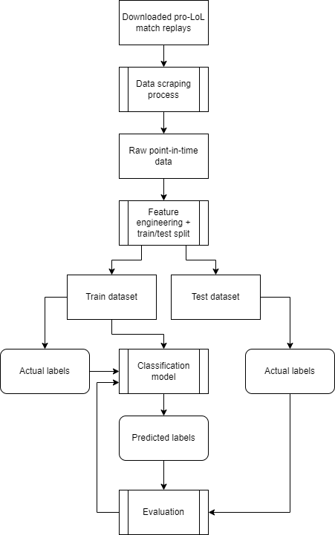
Process workflow
- Data Processing
Feature Engineering
Model Selection
Evaluation methodology

